Slide 1
Week-8
COSC 32001 Computer Vision
Noopa Jagadeesh
Date: 7 March 2024

Slide 2
Recap
Edge Detection
Contour Detection
Motion Detection: Background Subtraction
Assignment#2 Student Presentation

Slide 3
Agenda
Motion Detection
Frame Differencing
Optical Flow
Background Subtraction
Hough transform

Slide 4
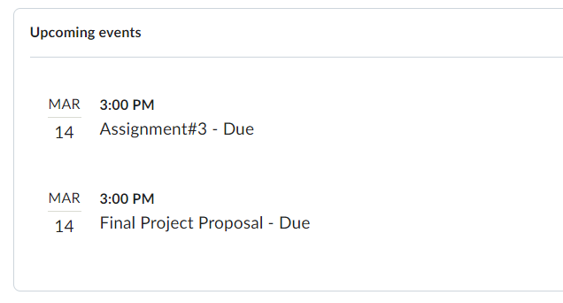
Critical Path

Slide 5
Motion Detection

Slide 6
Motion Detection
How can motion can be detected in a video?
Motion Detection is the process of detecting moving objects within a video sequence. In Computer Vision, it is the process of detecting a pixel-wise change across the video frames. We can use it to discover new objects in the real world.
Frame Differencing
Optical Flow
Background Subtraction

Slide 7
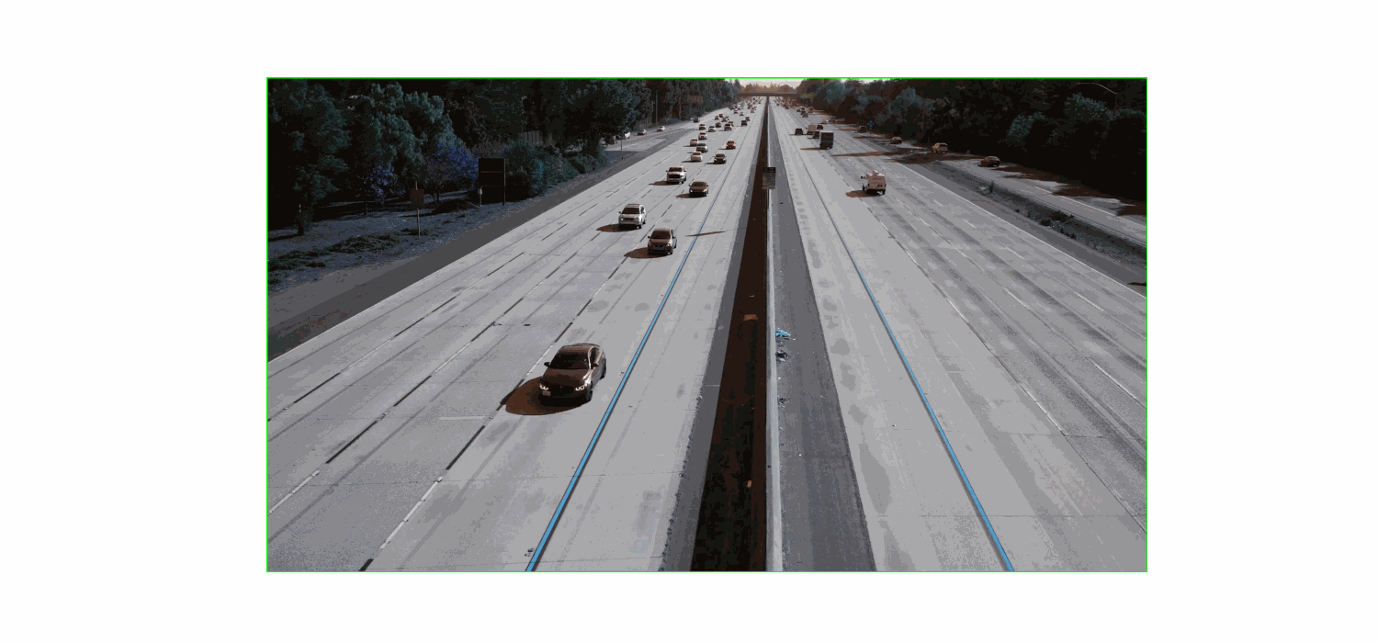
Frame Differencing
This is the easiest way to do motion detection.
The approach relies on something called Frame Differencing which is subtracting the current video frame from the previous one and noting the differences, these differences correspond to motion.
The outline of the approach is:
Compute the grayscale Frame Difference
Threshold the Frame Difference to get the Motion Mask
Find Contours in the Motion Mask and get their Bounding Boxes
Perform Non-Maximal Suppression on the detected Bounding Boxes
The main idea is, we threshold the frame difference to get a motion mask which provides rich information about moving objects in the scene. The motion mask, is the essence of all the three methods (in the previous slide).

Slide 8
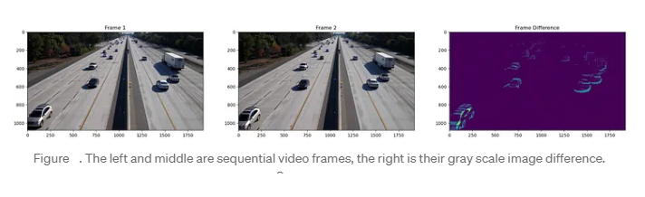
Frame Differencing
1. Computing the Initial Frame Difference
Frame Differencing is simply subtracting the current image from the previous one in the sequence.
A key assumption for this method is that the camera must be stationary, if the camera moves we will have to employ more advanced techniques such as camera motion compensation to accurately determine which objects are moving.
Even though the camera is stationary we may not always get reliable results, their can be many shadows in the images that can cause false targets. Also, the size of the moving objects will greatly vary, they will be significantly larger and with greater pixel motion at the bottom of the image

Slide 9
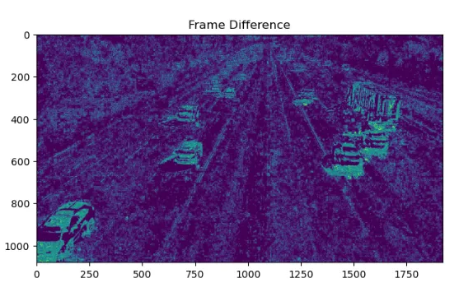
Frame Differencing
It turns out that the frame difference alone is not a good indicator of object motion, it has so much noise.

Slide 10
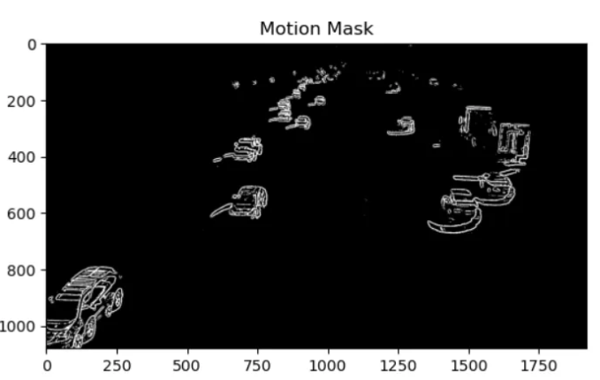
Frame Differencing
2. Compute the Motion Mask
In order to remove the noise, we will need to apply a threshold to the frame difference and obtain a binary motion mask.
In practice we will also use Blurring and Morphological Operations to improve the quality of the motion mask.
Notice how the shadows of some vehicles are still being detected, this is because the shadows correspond to a change in pixel intensity between the two frames. We can not always remove them with the frame differencing approach.
Now we can see that the motion mask has most of the background removed, while the moving cars remain. We will use this to make an object detector.

Slide 11
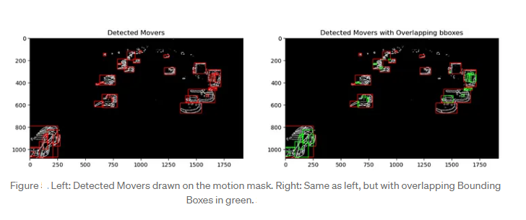
Frame Differencing
3. Turning the Motion into Detection
To get bounding box detections, we will find the contours on the motion mask, and then draw a bounding box around them if they are large enough.
Most object detectors also have a score or confidence level that usually ranges from 0–1. In this case, we don’t have either, but we will use an augmented score based on the area of each bounding box, where the larger area indicates a higher score.
The main assumption for this is that the largest contour (and largest bounding box) will usually correspond to the real object or cluster of objects. While the smaller bounding boxes may correspond to other details of the object such as contours extracted from it’s internal textures or shadows.
The resulting detections are drawn over the motion mask as below:
Now we have another issue! We have multiple false detections in the form of overlapping Bounding Boxes. We will eliminate this with Non-Maximal Suppression (NMS).

Slide 12
Frame Differencing
4. Non-Maximal Suppression
Object Detectors are not always perfect and sometimes require post processing to improve their performance.
Non-Maximal Supression is the process of removing unlikely detections (usually duplicate detections), it is a common part of powerful object detectors such as YOLO.
We will use the following algorithm to implement non-maximal suppression.
Sort detected boxes by score(area) and store them in array
Remove boxes that are entirely contained within another box
Start with the largest box
Compare it with all other boxes
If IOU exceeds the threshold, remove it
Repeat for next largest remaining box until complete
Intersection Over Union or IOU, it’s a way of determining how much overlap one bounding box has with another and has a range from 0 to 1

Slide 13
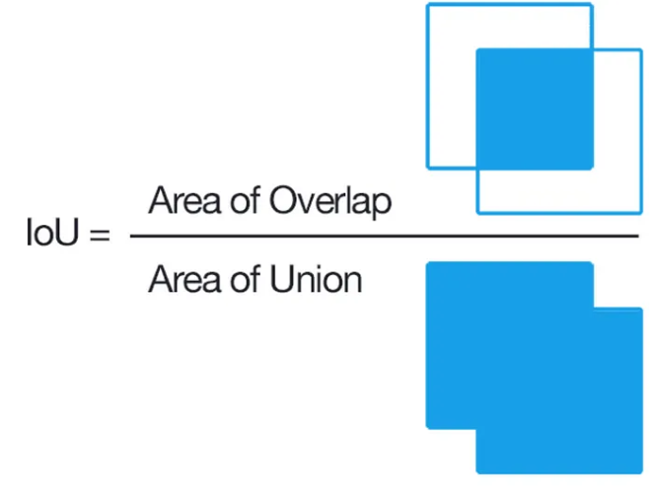
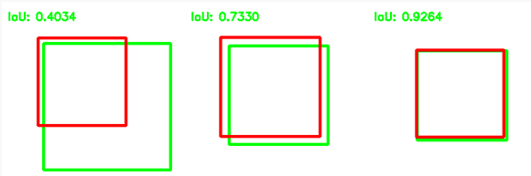
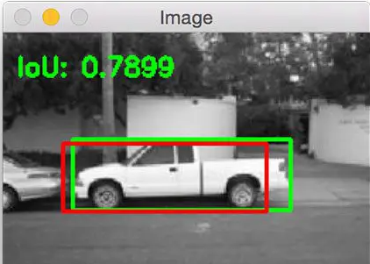
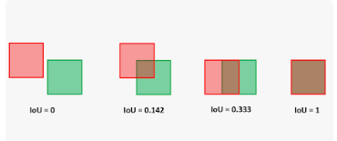
Frame Differencing

Slide 14
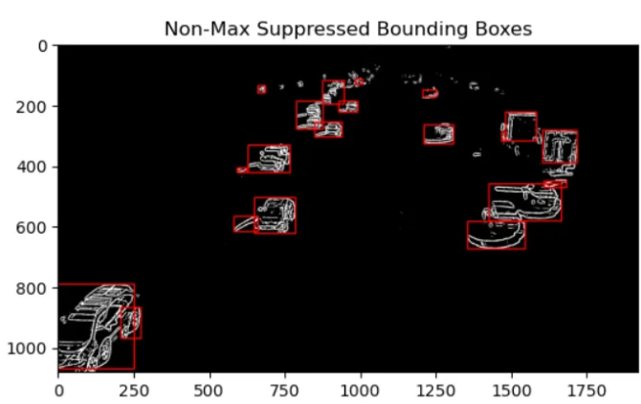
Frame Differencing

Slide 15
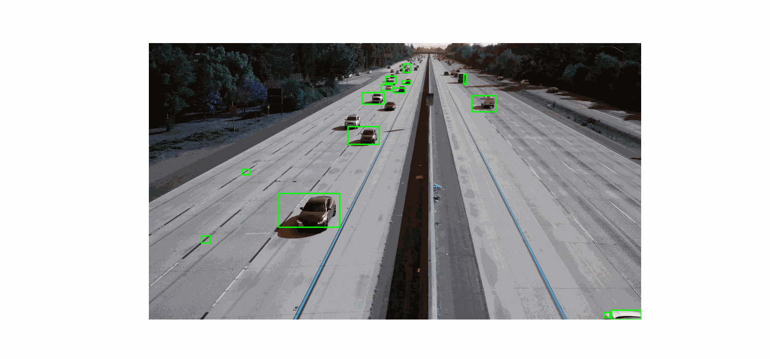
Frame Differencing
We can notice that there are many small false detections as well as bounding boxes that vary in size for the same clusters of objects.
We can also notice that the truck on the right side has multiple detections, generally one for the front and one for the back. The algorithm thinks that it is two separate objects.

Slide 16
Dense Optical Flow
The approach to Motion Detection with Optical Flow is similar to that of Frame Differencing.
The main difference is in the first step, we will get initial motion information from Optical Flow instead of frame differencing.
The algorithm is outlined below:
Compute Dense Optical Flow
Threshold Optical Flow to get Motion Mask
Find Contours in the Motion Mask and get their Bounding Boxes
Perform Non-Maximal Suppression on the detected Bounding Boxes
1. Compute Dense Optical Flow
The first step is to compute Dense Optical Flow between the current and previous image frames.
There are many method, a simple one is Farneback’s method in OpenCV. Another is Lucas-Kanade Optical Flow. We could also use Deep Learning approach such as RAFT (Recurrent All-Pairs Field Transforms).

Slide 17
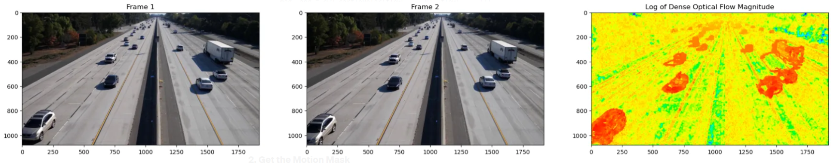
Dense Optical Flow

Slide 18
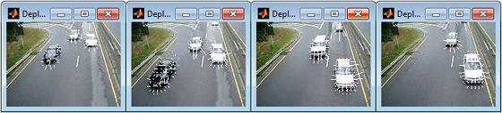
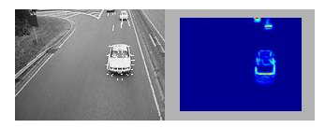
Optical Flow
What Is Optical Flow?
Optical flow is the distribution of the apparent velocities of objects in an image.
By estimating optical flow between video frames, you can measure the velocities of objects in the video.
In general, moving objects that are closer to the camera will display more apparent motion than distant objects that are moving at the same speed.
Optical flow estimation is used in computer vision to characterize and quantify the motion of objects in a video stream, often for motion-based object detection and tracking systems.
Optical flow estimation to obtain motion vectors (left) and pixel velocity magnitudes (right).
Moving object detection in a series of frames using optical flow.

Slide 19
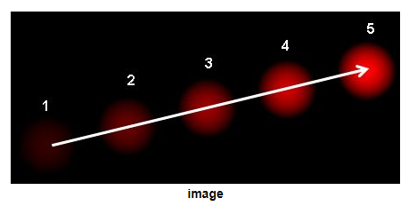
Optical Flow
Optical flow is the pattern of apparent motion of image objects between two consecutive frames caused by the movement of object or camera. It is 2D vector field where each vector is a displacement vector showing the movement of points from first frame to second.
A ball moving in 5 consecutive frames.
Given a video, optical flow is defined as a 2D vector field describing the ap- parent movement of each pixel due to relative motion between the camera (ob- server) and the scene (objects, surfaces, edges). The camera or the scene or both may be moving

Slide 20
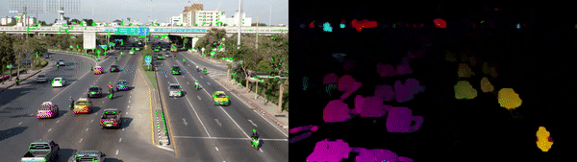
Optical Flow
Sparse vs Dense Optical Flow
Sparse optical flow provides the flow vectors for selected “interesting features” (such as the edges or corners of an object) in the frame, whereas Dense optical flow provides the flow vectors for all pixels in the frame, up to one flow vector per pixel. As expected, Dense optical flow offers higher accuracy but comes at the cost of being computationally expensive and slow.
The left image represents Sparse Optical Flow, which tracks a limited number of “feature” pixels while the right image shows Dense Optical Flow, which estimates the flow of all pixels in the image.

Slide 21
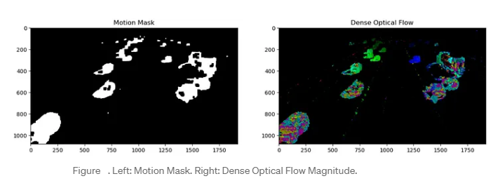
Dense Optical Flow
2. Get the Motion Mask
Now we can use the Dense Optical Flow to get the Motion Mask. We need to perform some Morphological Operations after thresholding to get a good quality mask.
We can also do something different with the thresholding.
Instead of using a constant threshold, we can incorporate the knowledge that objects at the top of the image are further away and hence smaller and have smaller pixel displacements. As opposed to closer objects at the bottom of the image which are larger size and displacement.
Notice how the Dense Optical Flow allows us to obtain a mask that actually segments the moving objects as opposed to the mask of outlines obtained with Frame Differencing.

Slide 22
Dense Optical Flow
3. Get Detections from Motion Mask
We can obtain detections from contours discovered on the motion mask.
We can also use Flow Angle to Filter Unlikely Detections. We may want to make full use of the Optical Flow and use the flow angle to filter unlikely detections. The main idea is that each moving object will have corresponding pixels that move in the same direction. So if we have a detection with flow angles that move in multiple directions (high variation), then we can remove it because it might not correspond to a real moving object.
We can approach this practically by setting a threshold based on the flow angle standard deviation of all pixels. If the flow angle standard deviation of a given contour exceeds this threshold, then we will not consider it as a detection.
4. Non-Maximal Suppression

Slide 23
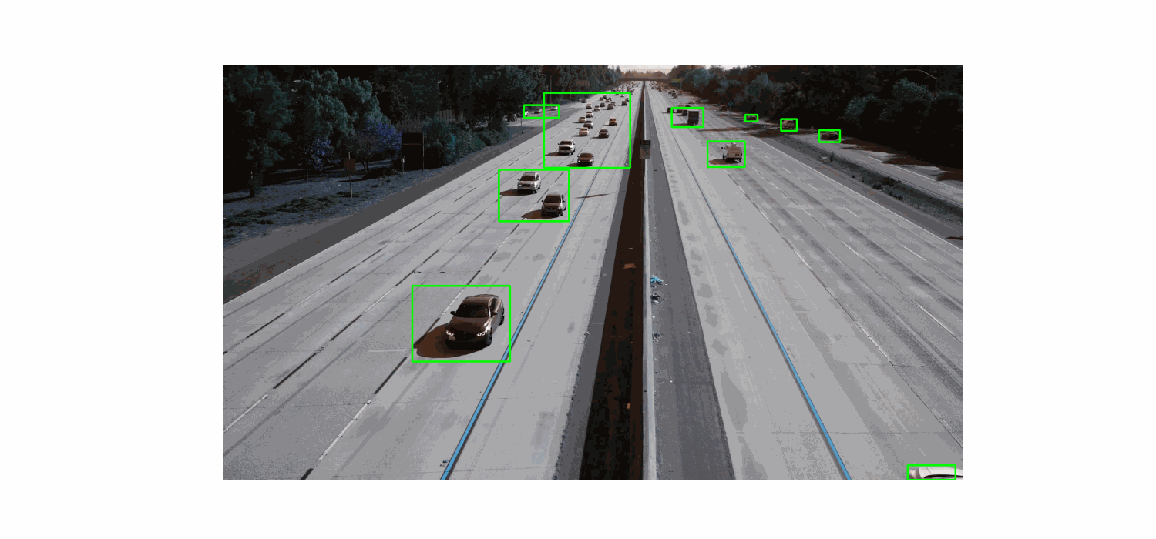
Dense Optical Flow
Motion Detection from Optical Flow

Slide 24
Background Subtraction to detect motion
In Background Subtraction, a learned background model is subtracted from the current frame to obtain a foreground mask.
The algorithm is outlined below:
Initialize Background Model
Update Background Model with new image frame
Obtain Foreground Mask from Background Model
Obtain Clean Motion Mask from Foreground Mask
Obtain initial motion detections from Motion Mask
Perform Non-Maximal Suppression on initial motion detections
Repeat steps 2–6
The Background Modeling consists of two main steps:
Background Initialization
Background update
The background model becomes more accurate as more images are fed into. The two powerful Background models in OpenCV are: MOG2 and KNN.
MOG2 stands for Mixture of Gaussians 2 (it is an improved approach from MOG) and KNN stands for K Nearest Neighbors

Slide 25
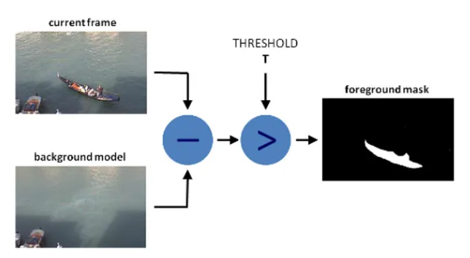
Background Subtraction
Concept of Background Subtraction

Slide 26
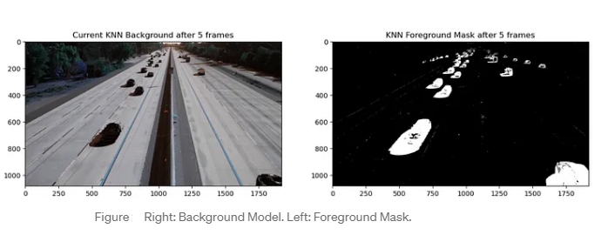
Background Subtraction
Each Background model contains an option to detect shadows, the shadow threshold must be tuned.
The overall effectiveness of shadow detection seems to depend on the data (sometimes it’s effective and sometimes it’s not).
Even after five frames, the background model is able to give us an accurate foreground mask.

Slide 27
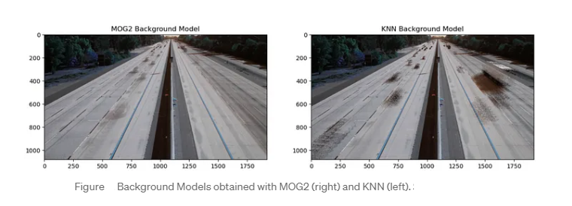
Background Subtraction
Obtained background models for MOG2 and KNN after only 90 frames.

Slide 28
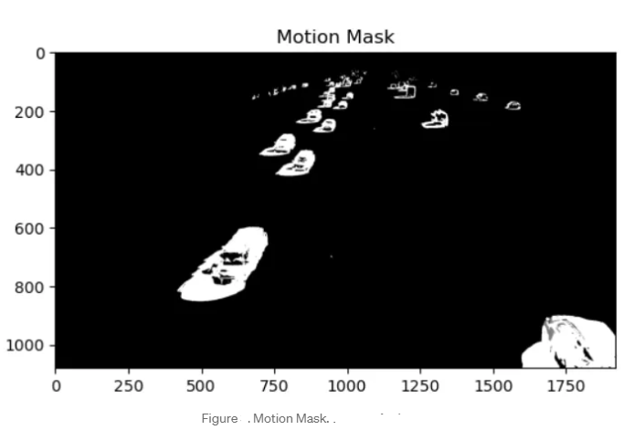
Background Subtraction
Next step would be to process (threshold+morphological operation) the foreground mask to get a clean motion mask.

Slide 29
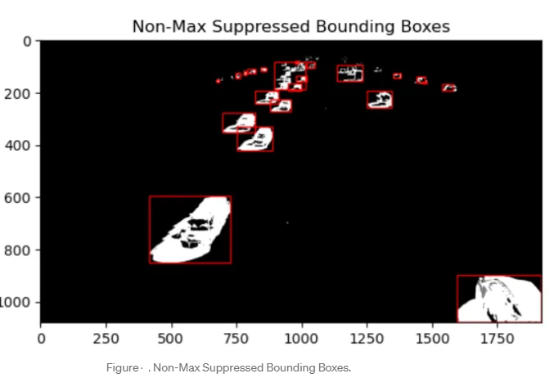
Background Subtraction
Now that we have the motion mask, we can obtain non-max suppressed detections(This covers steps 5 and 6 in the algorithm).

Slide 30
Background Subtraction
Moving Object Detections with KNN Background Subtraction.

Slide 31
Background Subtraction
Moving Object Detections with MOG2 Background Subtraction

Slide 32
Background Subtraction
With Background Subtraction, we are able to detect much smaller objects in the video, even smaller than what a deep object detector such as YOLO would be able to detect.
However, this comes with the consequence that there are many spurious small detections that are false. We can mitigate against this by using an object tracking algorithm like SORT.

Slide 33
Hough transform

Slide 34
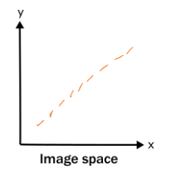
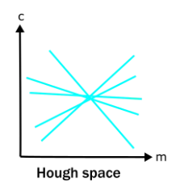
Hough Transform
Hough transform is a feature extraction method used in image analysis.
Hough transform can be used to isolate features of any regular curve like lines, circles, ellipses, etc.
It is a technique that locates shapes and boundaries in images.
Consider a line in the image space which is an edge detected and has small discontinuities. To find the continuous line in an image we can transform this discontinuous line in image space to Hough space and look for intersection points in Hough space. This intersection point in Hough space will represent the continuous line in image space.

Slide 35
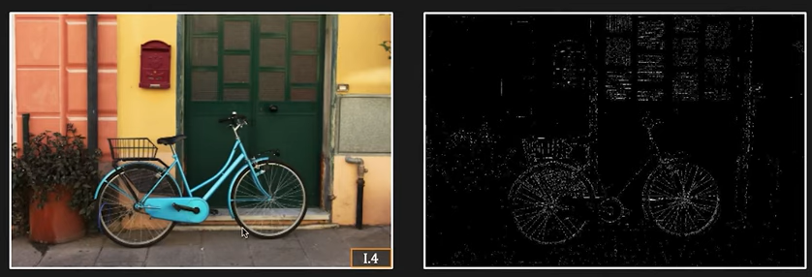
Hough Transform | Boundary detection
One of the problems with boundary detection is knowing which edges in an image actually correspond to the boundary that we're looking for. If we knew that, that would be half the problem solved.
Hough transform gives us a very elegant very powerful way of solving this problem when the boundary can be described using a small number of parameters.
But first let's talk about the problem itself. So here we have an image and its edge map. And let's say we want to find the two wheels of this bicycle, which can be described as circles. And we can indeed see the circles in the edge map, but we have lots of other stuff here.

Slide 36

Hough Transform
Which points do we actually fit the circles to? Very
hard problem.
In this image, we can see that some parts of the wheel are actually incomplete in the edge map and in fact, the problem could be much worse if the wheels were being obstructed or occluded
by other objects.
We have lots of edges close to the wheels
and maybe even a little bit far away
which don't actually correspond to real edges,
but we have to deal with them given that they
appear in the edge map
So the Hough transform, which was invented in the early 1960s gives you a very powerful way to deal with these three problems in one shot.

Slide 37
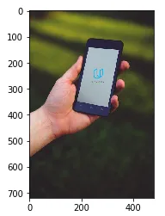
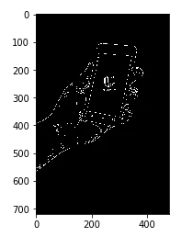
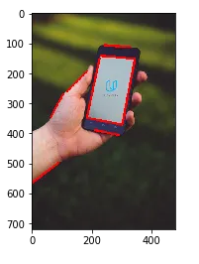
Hough Transform
Find lines using Hough transform
Performing Edge detection
cv2.HoughLinesP()

Slide 38
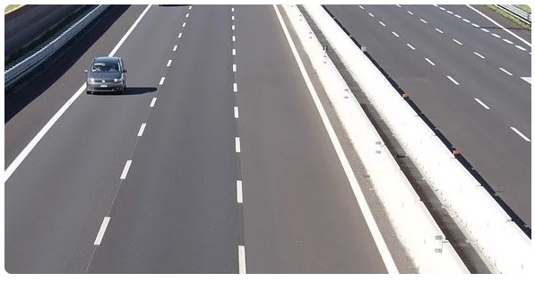
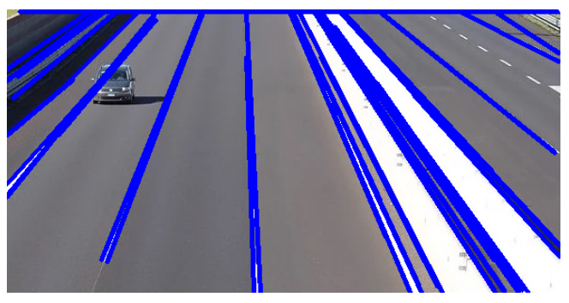
Hough Transform | Line Detection

Slide 39
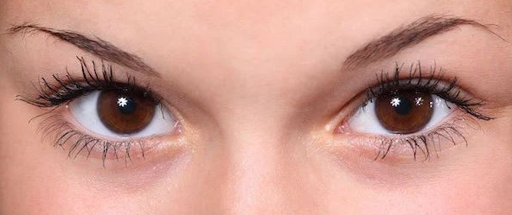
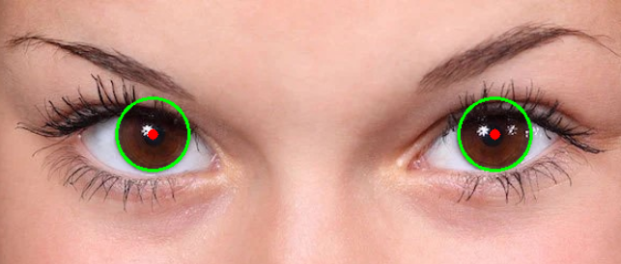
Hough Transform | Circle Detection

Slide 40
Disclaimer
Due to nature of the course, various materials have compiled from different open source resources with some moderation. I sincerely acknowledge their hard work and contribution

Slide 41


